Slide 1


Employee Insight and Company Values @ Orange Switzerland
Amelia Räss-Fernandez
Chief Human Resources Officer
Andrew Marritt
Founder, OrganizationView
London, October 16, 2014
HR change and innovation

Slide 2
Agenda
1st part - the company and its challenge
  Our company, values and people strategy
  The journey to a new approach to assessing employee engagement
  Take-aways
2nd part – how we do the analysis
  Aligned to the brand and values
  Innovation in the process of doing analysis
  Data science and survey data
  Where we’re heading

Slide 3
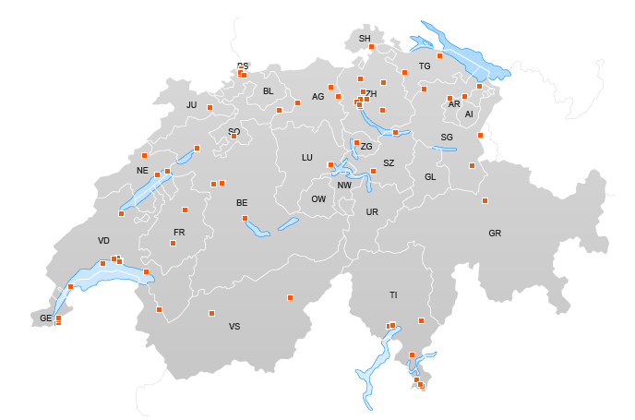
Our company at a glance
Launch on the Swiss market
Orange Switzerland sold to funds advised by Apax Partners
1999
2000
2012
France Telecom acquires the majority of shares
Zürich
  1’691’000 customers
> 99% of pop. coverage
94 Orange Centers
120 Orange Points
967 Employees & 50 apprentices
Biel
Lausanne (renens)

Slide 4

Our values are at the heart of everything we do
Exceptional service
We make you feel special
Simplicity
We take the complexity out of telecommunications
Refreshing
We dare to be original, in everything we say and do
Sincerity
We do what we say
Efficient
We focus on the essential
key drivers for
living the values
define beha-viours
to live them
commu-nicate them
again & again
hire (& fire) based
on values
make decisions with them
assess and reward
in line with them
train value-based behaviours
tell stories about them
Notes:
http://www.orange.ch/en/common/about-orange/company-profile/values/

Slide 5
Our people strategy is aligned with our values
Exceptional service
We make you feel special
Simplicity
We take the complexity out of telecommunications
Refreshing
We dare to be original, in everything we say and do
Sincerity
We do what we say
Efficient
We focus on the essential
Foster a service-oriented culture through a strong performance management process, linked to rewards & development opportunities, while increasing employee commitment.
Remove complexity out of HR services and support
Be perceived as an attractive and refreshing employer in order to attract, deploy, develop, and retain talented employees and best performers.
Embed our values in the employee life-cycle; recognize & reward living them
Further professionalise and optimise the HR function by focusing on
value-added, cost-effective and efficient services.

Slide 6
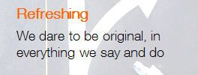
Employee insights help us measure the implementation of the people strategy
Measurement framework – example
Performance
Value driver
Priority
Measurement / KPI
2013
Target
2014
Faster production
Reduced error rate
Reduced number of line manager inquiries
1 w
10
10
1 day
2/3
5
1 h
1
2
Revamp employee survey
Align internal & HR communication values and brand
(letters, emails, career site
% completion
Stakeholder feedback
100% Formal, boring
80% - Pareto rule
60%

Slide 7
We align our internal and external communication
Old salary increase letter
Refreshed letter
Dear
Following the annual salary review, we are pleased to inform you that your salary was increased by 1%, namely CHF
As of 1st April 2013, your monthly salary is CHF
We thank you for your commitment in the past year and look forward to a successful year 2013.
Kind regards,
Hello you,
2013 has been very busy and 2014 will bring for sure its own challenges along!
Fortunately, we could count on you! And it’s time to say thank you. Of course, we could use usual salutations but let’s go straight to the point!
As of 1st April 2014, your annual salary is CHF
We’re sure you are good at mathematics, but to keep it simple: it has been increased by % namely CHF.–
Again, a big THANK YOU and let’s continue this successful collaboration!
Cheers,

Slide 8
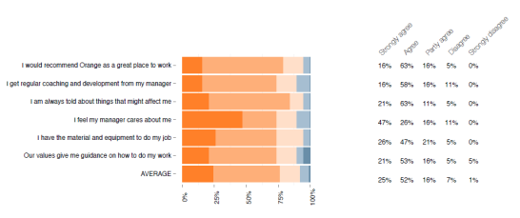

The journey to better employee insights
Past employee survey
What we did
long, in-depth survey
manual
resource consuming
moderate response
not so easy to translate into action
Shortened, more focused questionnaire:
  6 questions
  Comments
Regular
Senior management role
Automated and outsourced production & reporting

Slide 9
The revamped employee survey
6 closed and 1 open question in 4 languages
I would recommend Orange as a great place to work
I am always told about things that might affect me
I feel my manager cares about me
I get regular coaching and development from my manager
I have the material and equipment to do my job
Our values give me guidance to do my work
If you could change one thing to improve your working life at Orange what would it be?

Slide 10




The revamped employee survey
If you could change one thing to improve your working life at Orange what would it be?
New, faster laptops
More transparency in communication between employees and top management
Nobody anyway reads this comments!!
Thanks for doing this survey

Slide 11
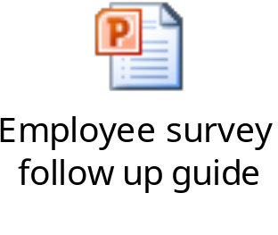
Translating results into action
Employee survey follow up guide
Preparation
Discussion and Development Plan
Aggregation Results
Implementation
Communication

Slide 12
Better employee insights as a result
Outcome
What’s next
Better insights drive action more quickly and efficiently
Increased employee engagement thorough tangible results
Faster results increase stakeholder satisfaction
Increased accuracy & therefore trust
Time savings invested in more value added tasks, increasing motivation
Link to performance data
Link to voluntary leavers

Slide 13

Take aways
Strategic alignment
Senior management commitment
Short
Regular
Results drive action

Slide 14
developing an approach suitable for Orange

Slide 15
Strong values – how do we deliver on these?
exceptional service
simplicity
refreshing
sincerity
efficient

Slide 16

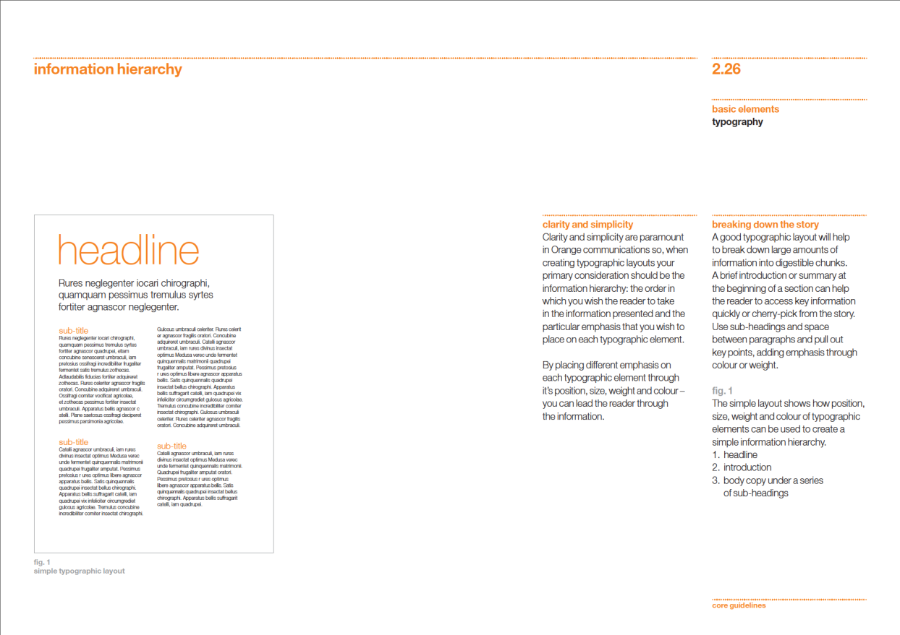
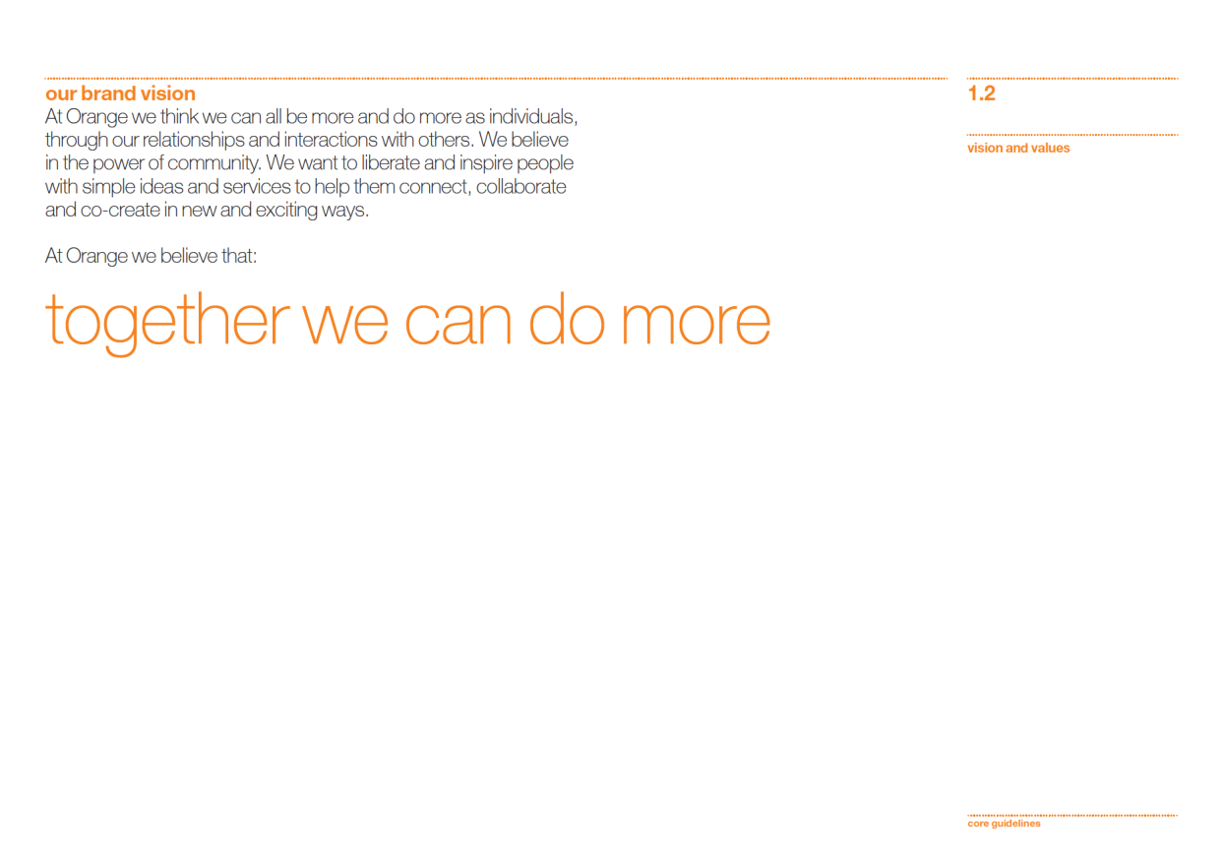
Strong brand – highest quality builds trust.

Slide 17
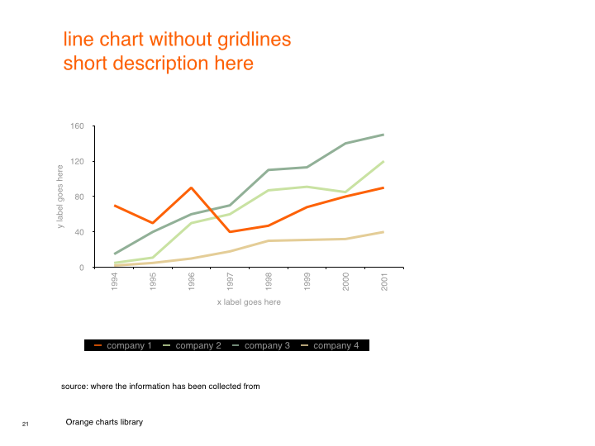
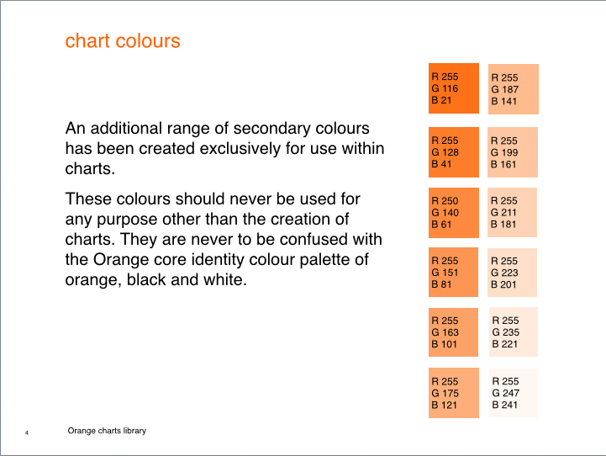
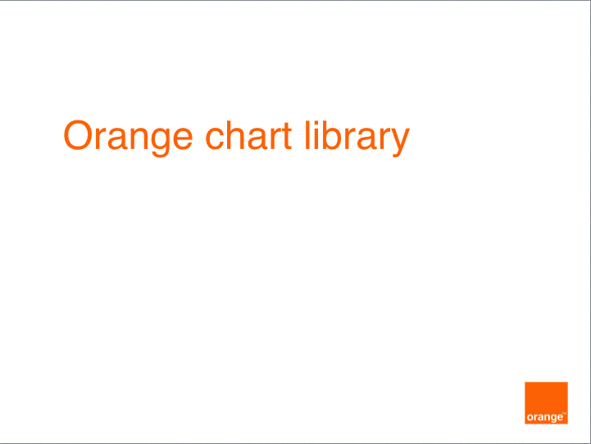
Strong brand - identity guidelines for charts.

Slide 18
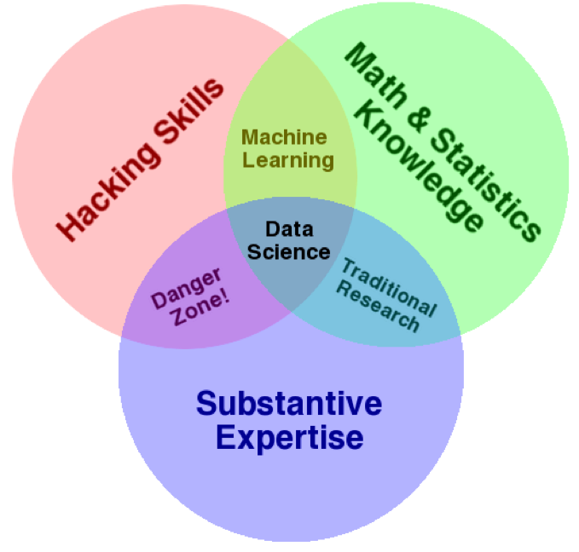
Data science approach

Slide 19
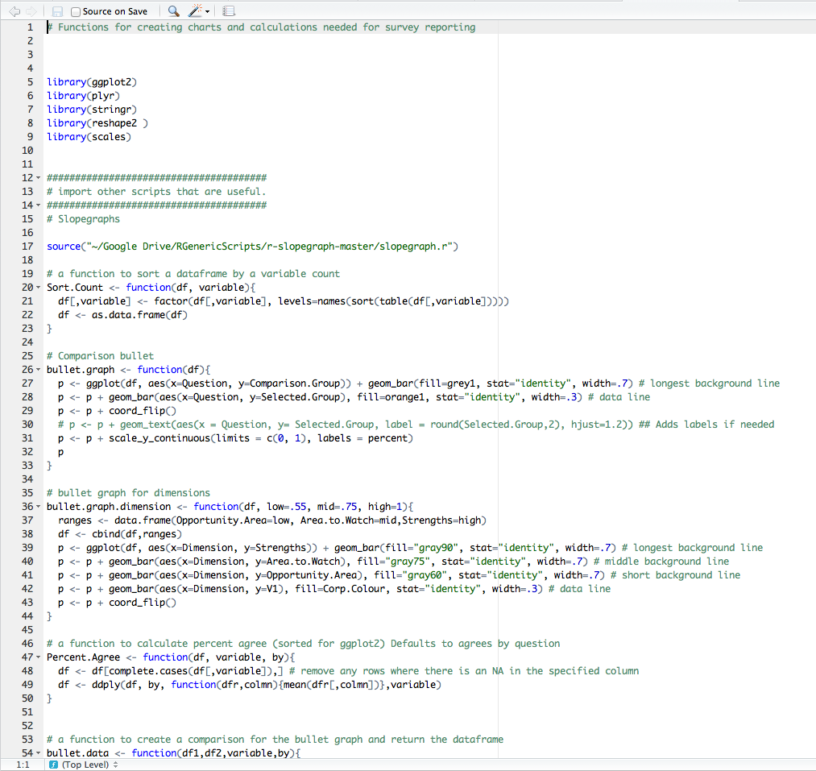
The importance of code
Code makes analysis:
  Reproducible
  Scalable
  Increases quality
  Decreases cost
  Fast

Slide 20

Technology progress during last 20 years

Slide 21

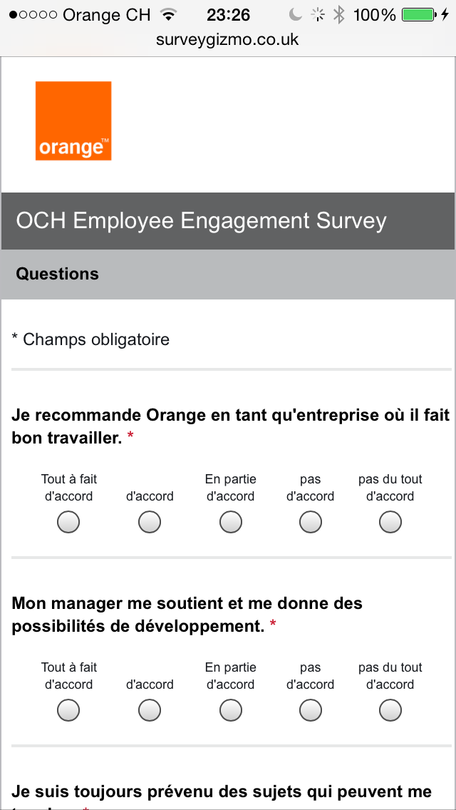
Mobile first

Slide 22
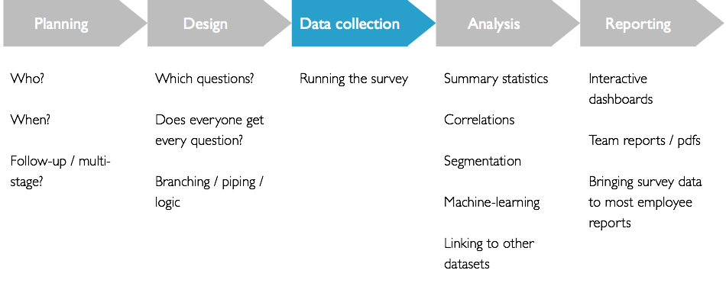
Simplifying the current process
Opportunity for code

Slide 23

Orange Switzerland as a Graph

Slide 24

Graph based reporting
Manager
Direct team
member
Broader team
member

Slide 25
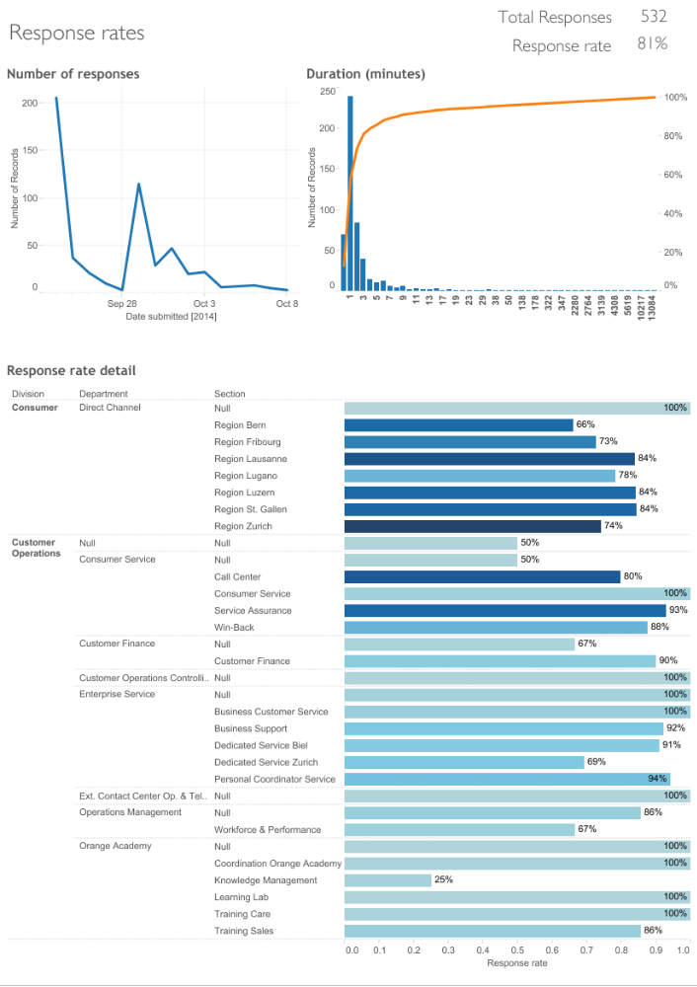
Monitoring responses in real-time

Slide 26
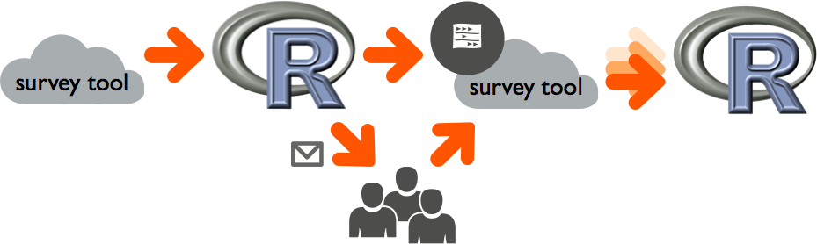
Automating classification of text comments

Slide 27
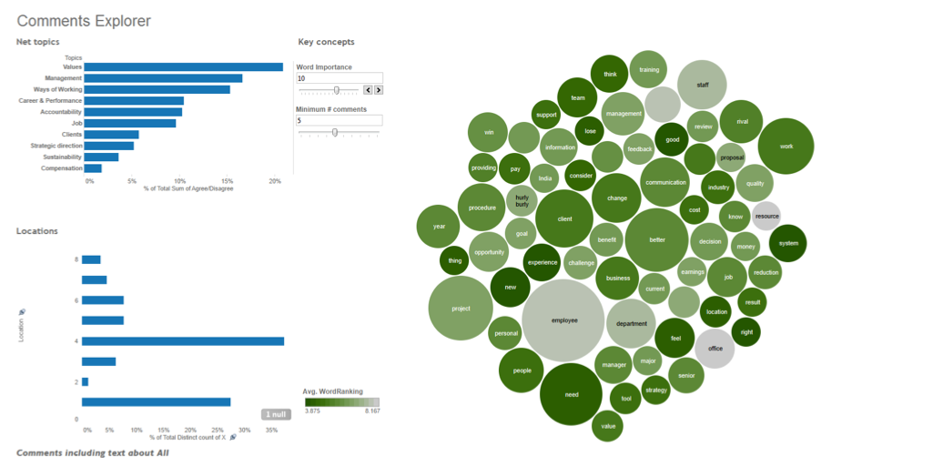
Exploring comments interactively

Slide 28
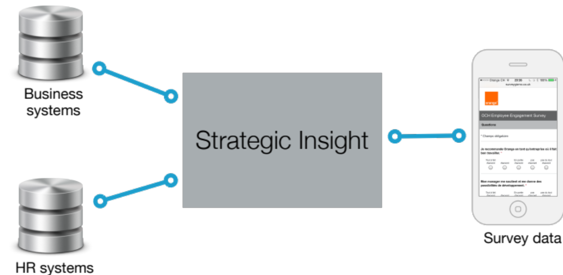
Joining data together

Slide 29
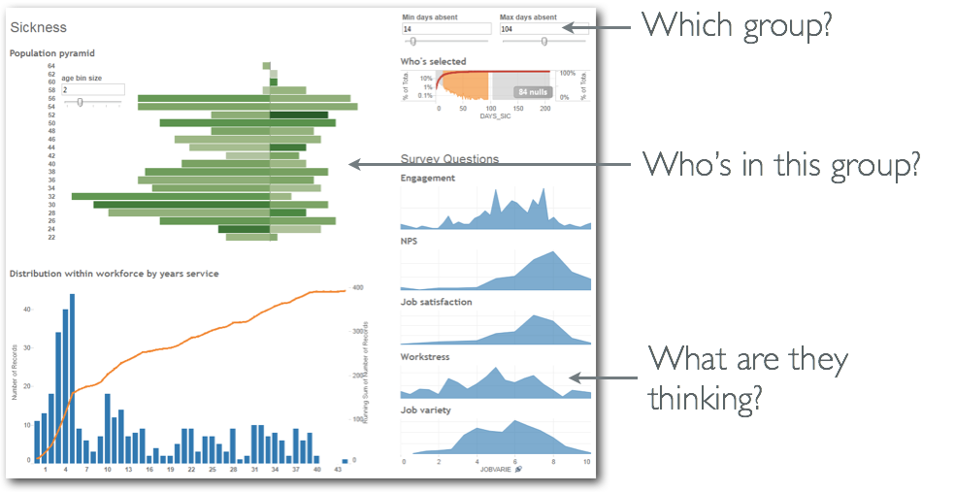
Integrating survey data in other reporting

Slide 30
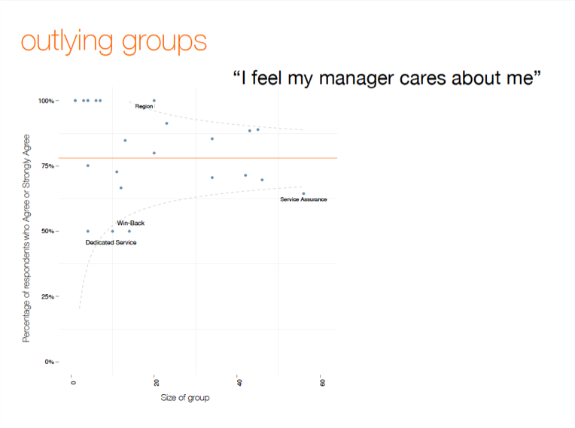
Don’t be scared of challenging norms, if you feel it’s better

Slide 31
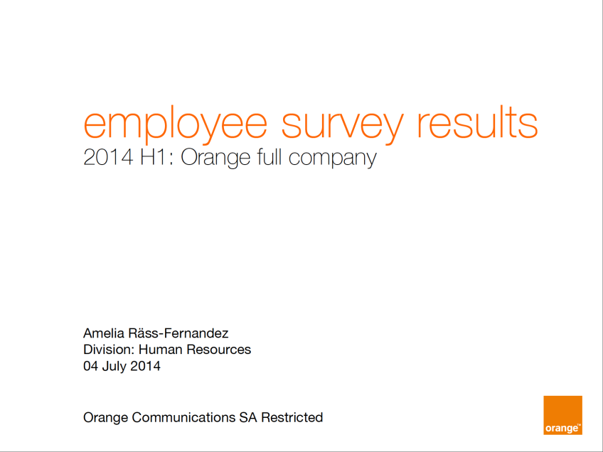
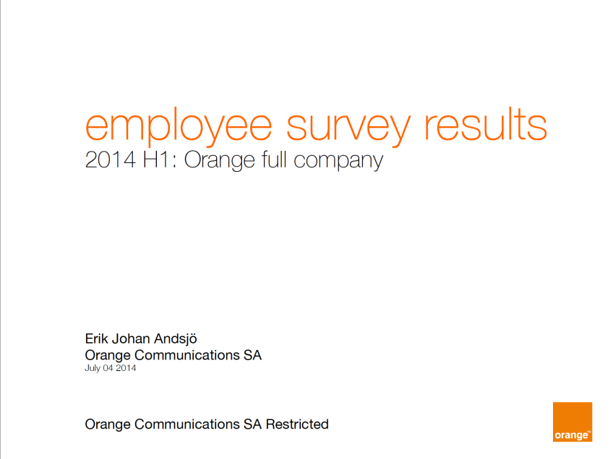
The immediate results
+
~110 versions

Slide 32

That’s all for now. Questions?

Slide 33

thanks

